Slide 1
the while loop
METEO 273, Spring 2024
Department of Meteorology and Atmospheric Science
The Pennsylvania State University

Slide 2
Anatomy of a while statement
while booleanExpression
expression
end
The while statement
booleanExpression what is checked each iteration
expression what is done every iteration

Slide 3
The while loop
The while loop executes the expression within the while-end block as long as statement is true.
while statement
expression
end

Slide 4
The while loop
The while loop executes the expression within the while-end block as long as statement is true.
expression must be true for the while loop to run the first time (or iteration).
expression must also change to false eventually or the while-end block will run forever (infinite loop!).
while booleanExpression
expression
end

Slide 5
The while loop
The while loop executes the statements within the while-end block as long as expression is true.
expression must be true for the while loop to run the first time (or iteration).
expression must also change to false eventually or the while-end block will run forever (infinite loop!).
This means you have to have a mechanism within the statements that could allow expression to become false.
while statement
expression
end

Slide 6
The while loop
The while loop executes the statements within the while-end block as long as expression is true.
expression must be true for the while loop to run the first time (or iteration).
expression must also change to false eventually or the while-end block will run forever (infinite loop!).
This means you have to have a mechanism within the statements that could allow expression to become false.
while statement
expression
end
expression is true?
No
Yes
statements

Slide 7
Example: Factorial
How can we use a while loop to solve for the factorial of a number?

Slide 8
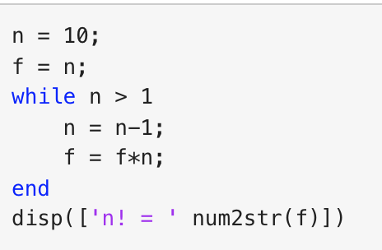
Example: Factorial

